Slide 1


TASK 3
ANALYSIS:
BF Algorithm based NN Search
BBS Algorithm based Skyline Search

Slide 2
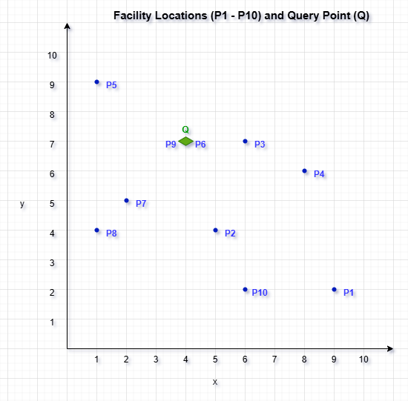
BF ALGORITHM BASED NN SEARCH
R-Tree Construction
ID | 1 | 2 | 3 | 4 | 5 | 6 | 7 | 8 | 9 | 10
X | 9 | 5 | 6 | 8 | 1 | 4 | 2 | 1 | 4 | 6
Y | 2 | 4 | 7 | 6 | 9 | 7 | 5 | 4 | 7 | 2
Query Point
ID | X | Y
1 | 4 | 7
20

Slide 3
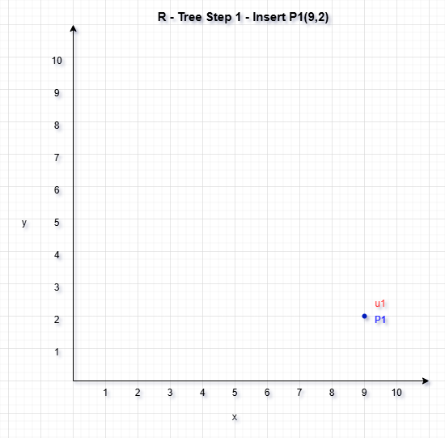
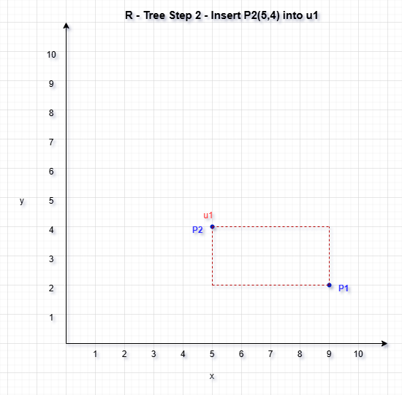
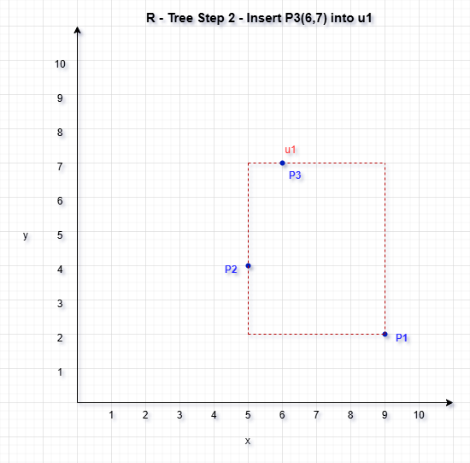
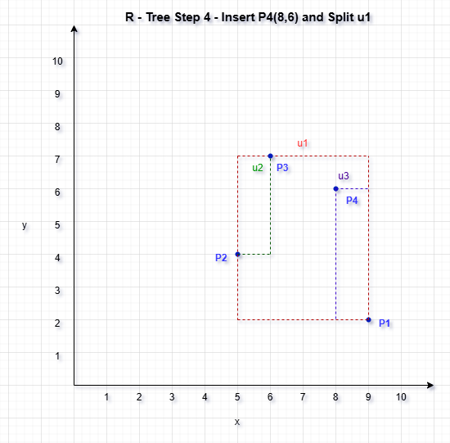
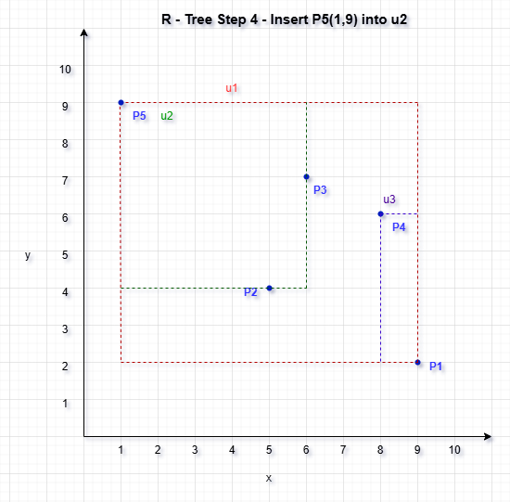
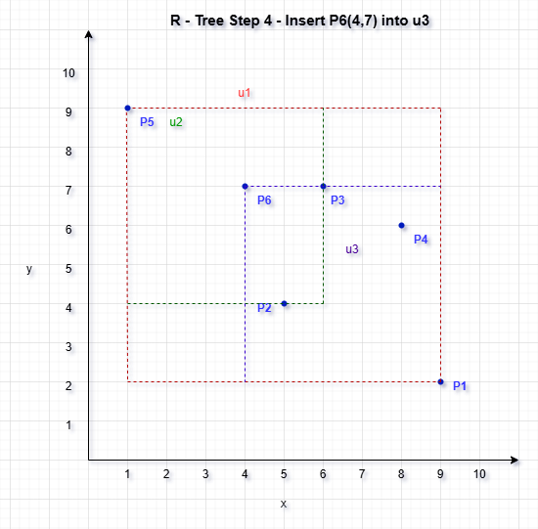
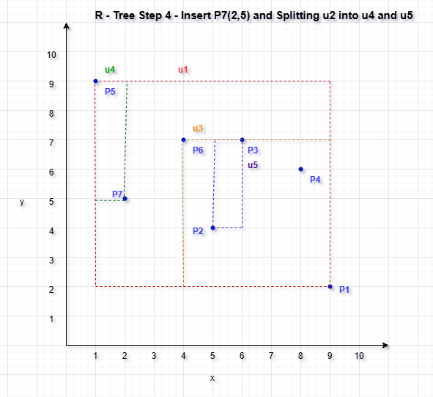
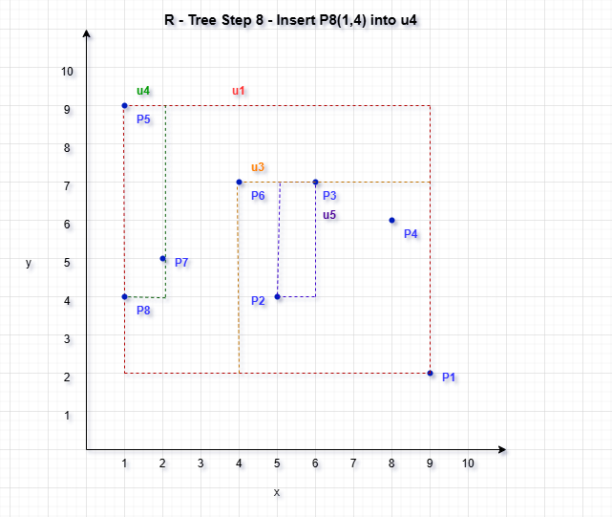
R-Tree Construction

Slide 4
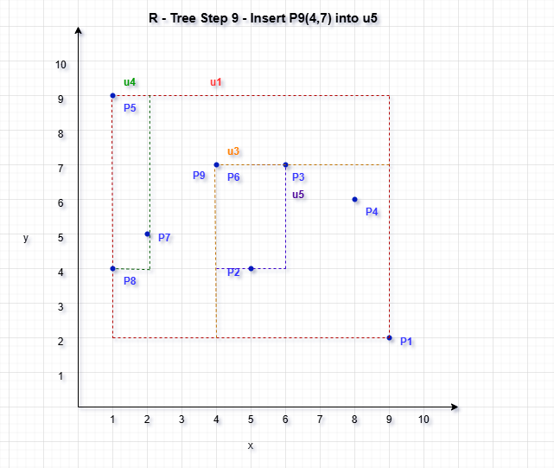
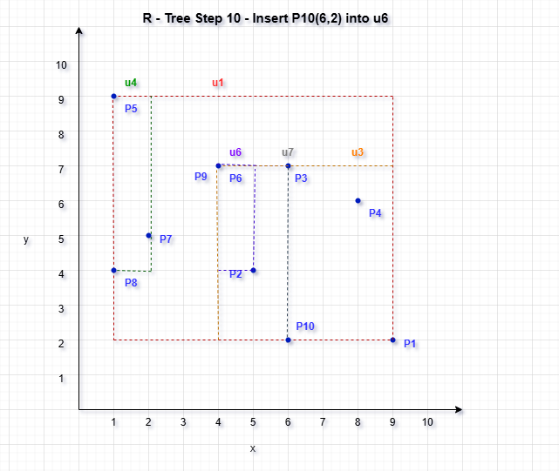
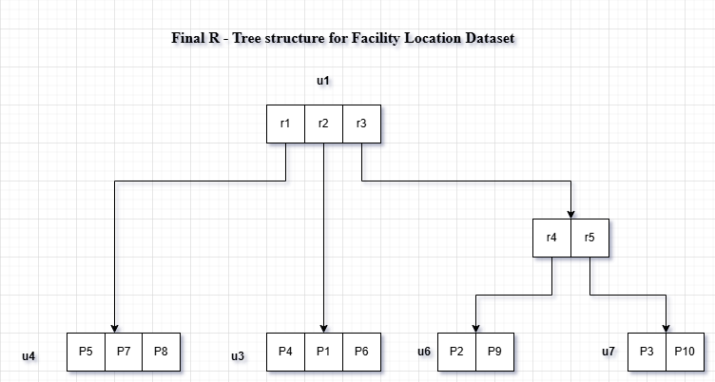
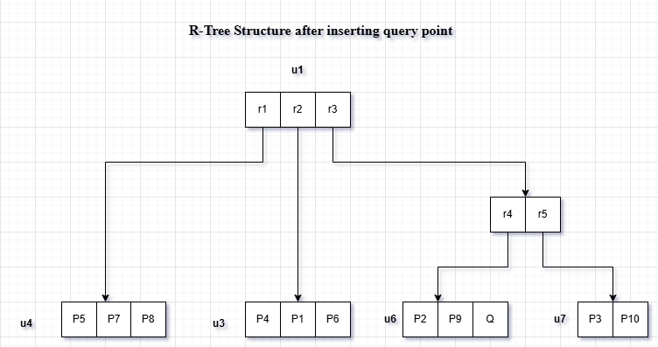
R-Tree Construction
The final R-tree diagram illustrates a spatial indexing structure built over ten facility location points (P1 to P10).
The R-tree structure provide resulting in a final structure where all points are efficiently indexed across 4 leaf nodes under a single root node.

Slide 5
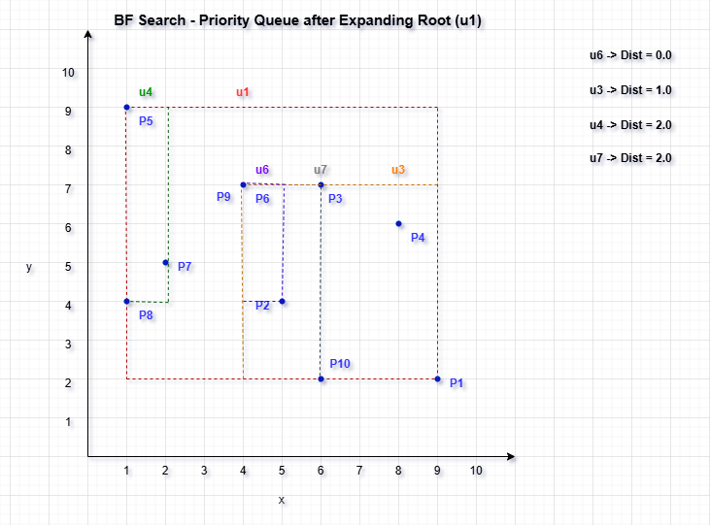
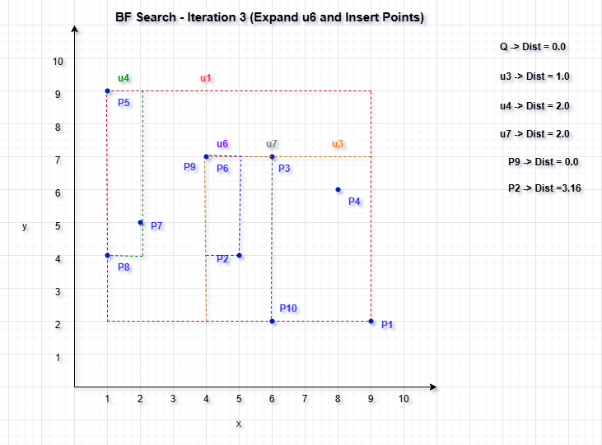
BF ALGORITHM BASED NN SEARCH
BF Algorithm Process

Slide 6
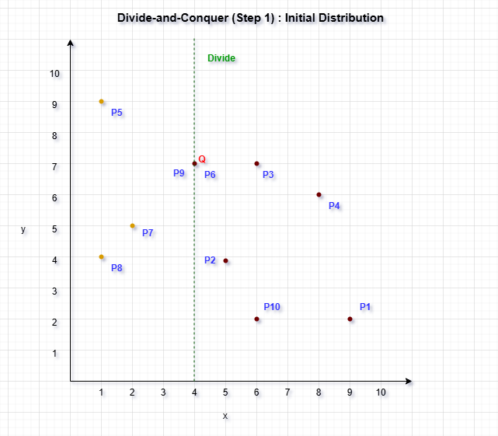
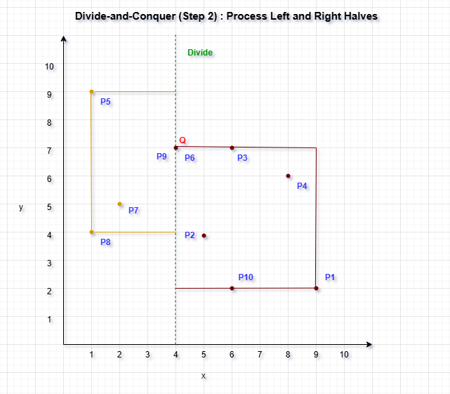
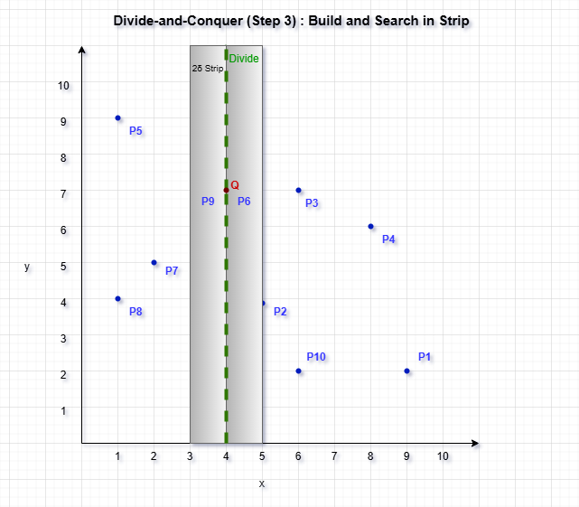
BF ALGORITHM BASED NN SEARCH
Divide & Conquer Process

Slide 7
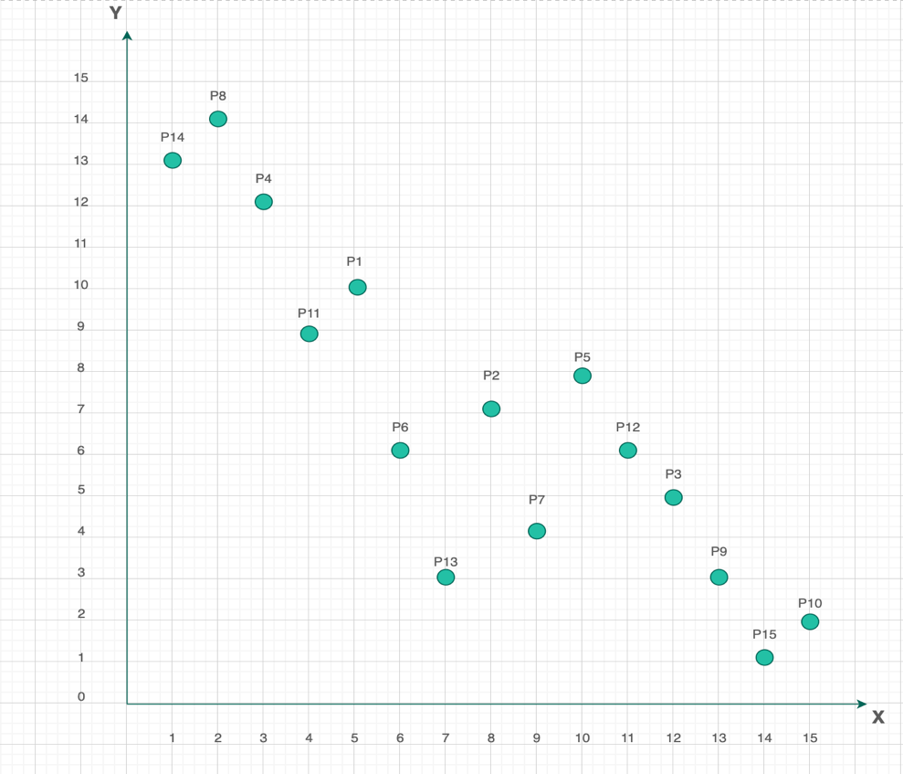
BBS ALGORITHM BASED SKYLINE SEARCH
R-Tree Construction
ID | 1 | 2 | 3 | 4 | 4 | 6 | 7 | 8 | 9 | 10 | 11 | 12 | 13 | 14 | 15
X | 5 | 8 | 12 | 3 | 10 | 6 | 9 | 2 | 13 | 15 | 4 | 11 | 7 | 1 | 14
Y | 10 | 7 | 5 | 12 | 8 | 6 | 4 | 14 | 3 | 2 | 9 | 6 | 3 | 13 | 1
Visualization of Skyline Search Dataset
28

Slide 8
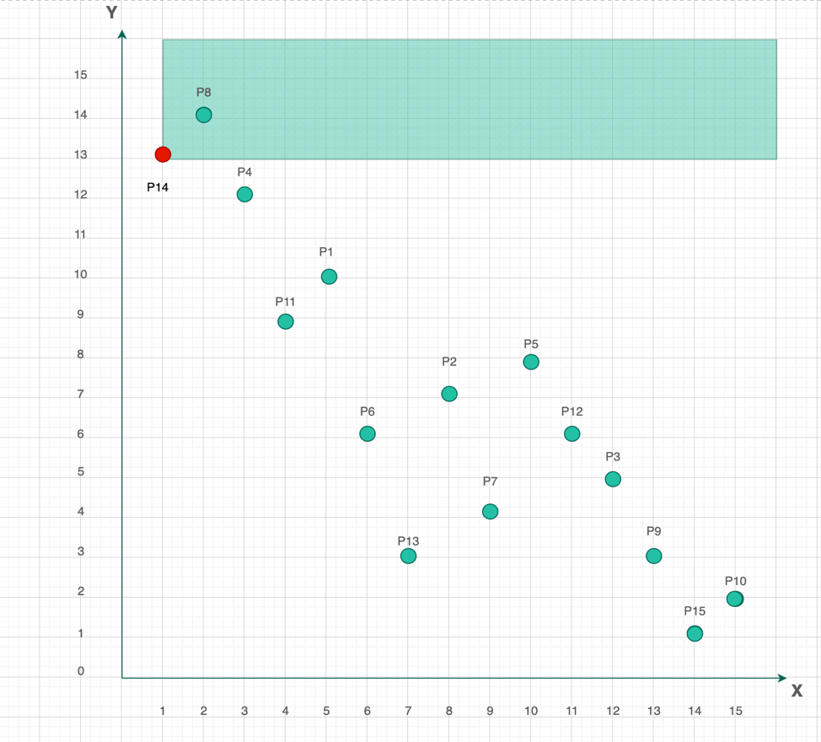
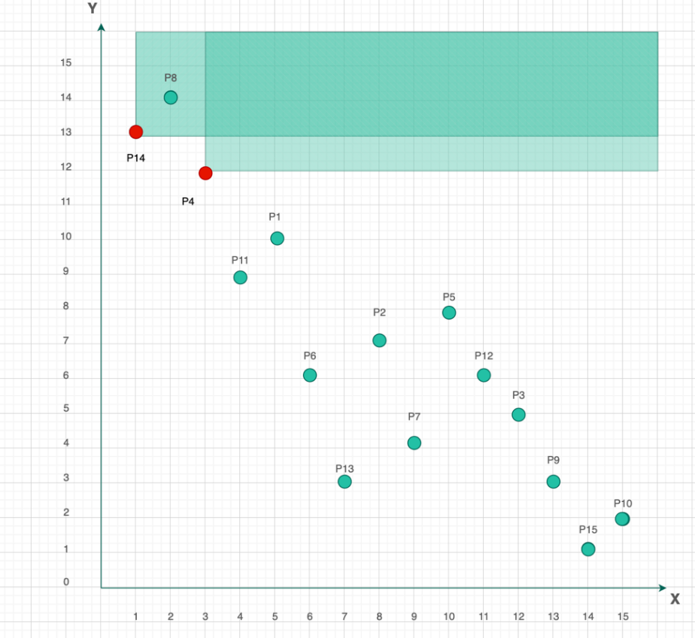
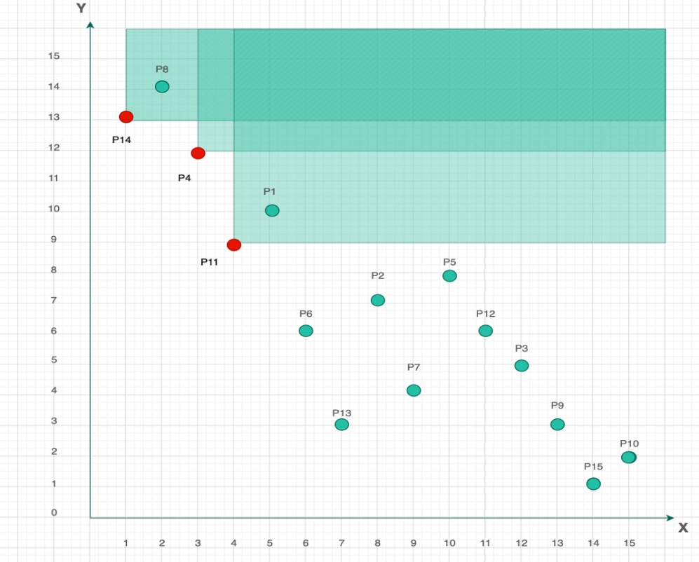
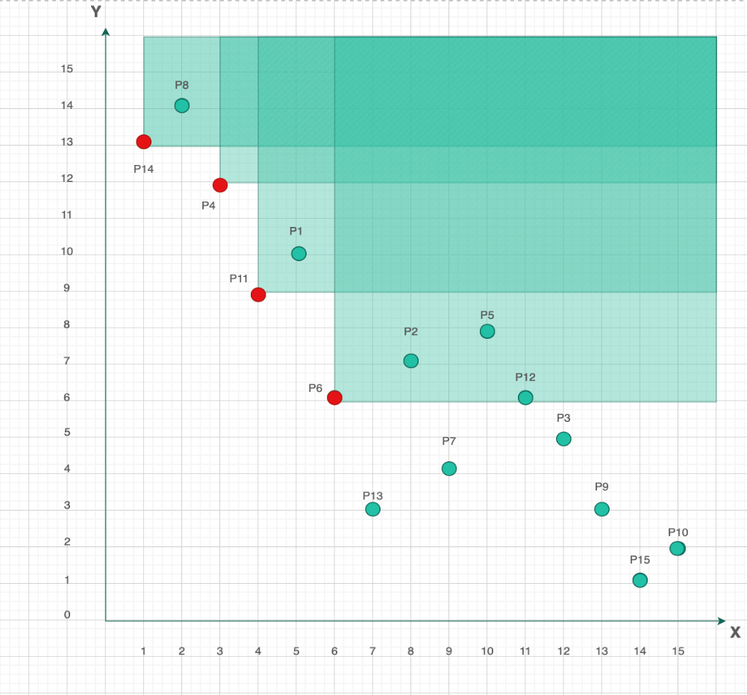
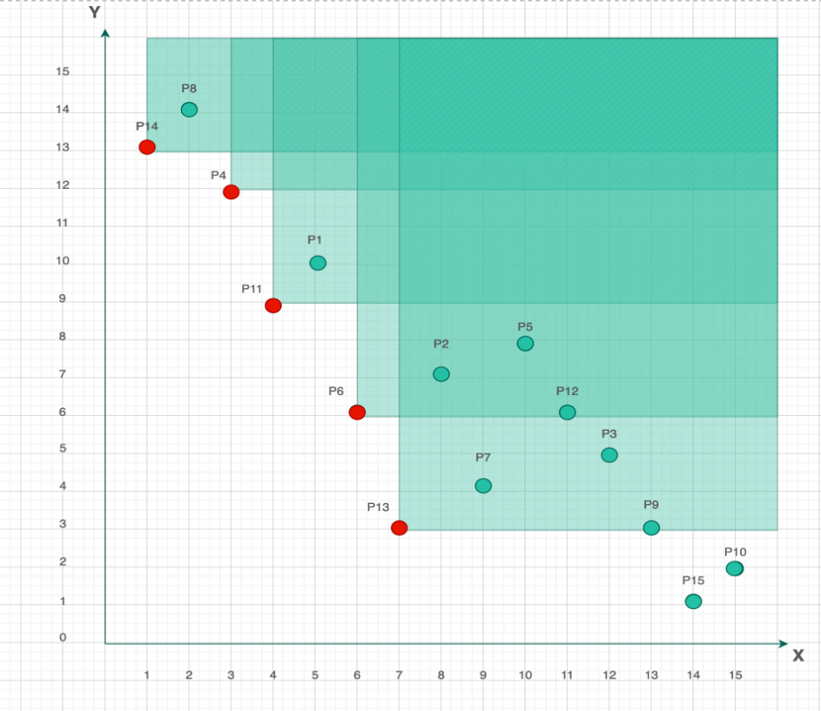
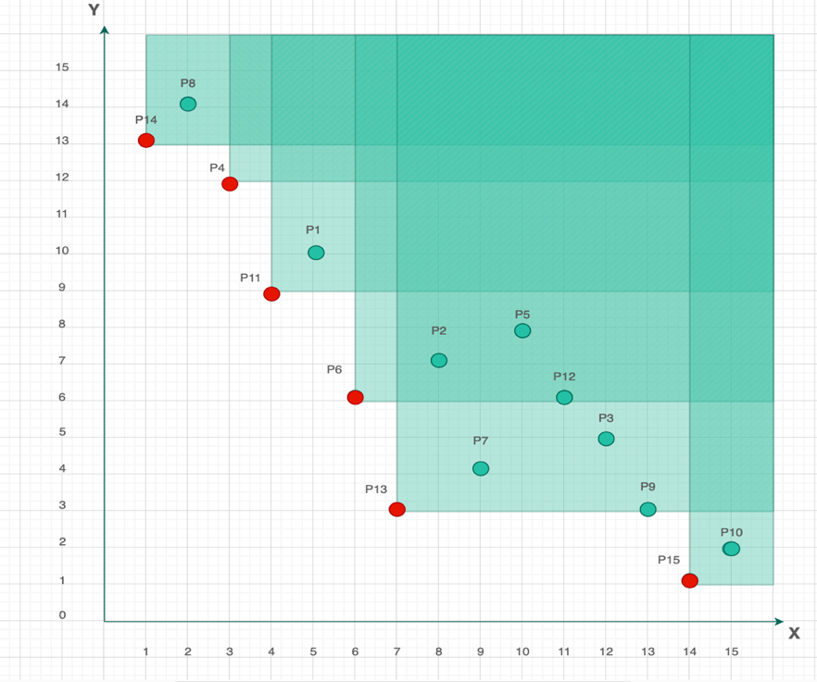
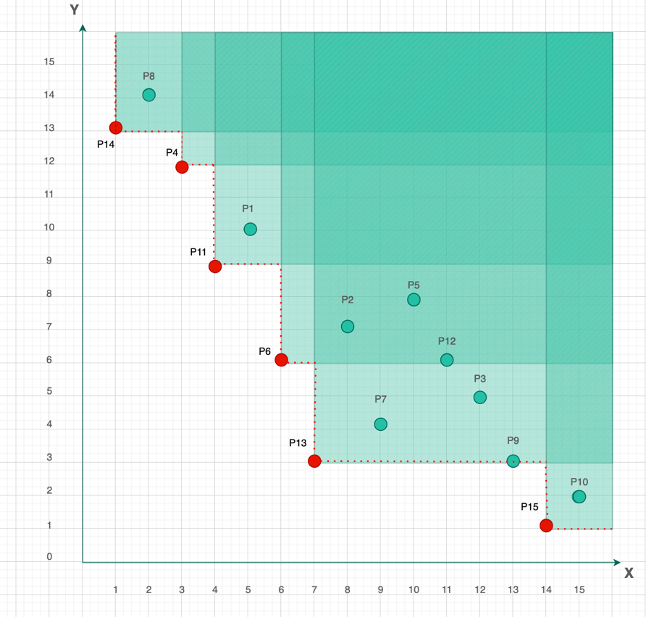
BBS ALGORITHM BASED SKYLINE SEARCH
R-Tree Construction
This shows the sequence of diagrams illustrating R-tree constructionby representing Skyline Coordinates from Left to Right
29

Slide 9
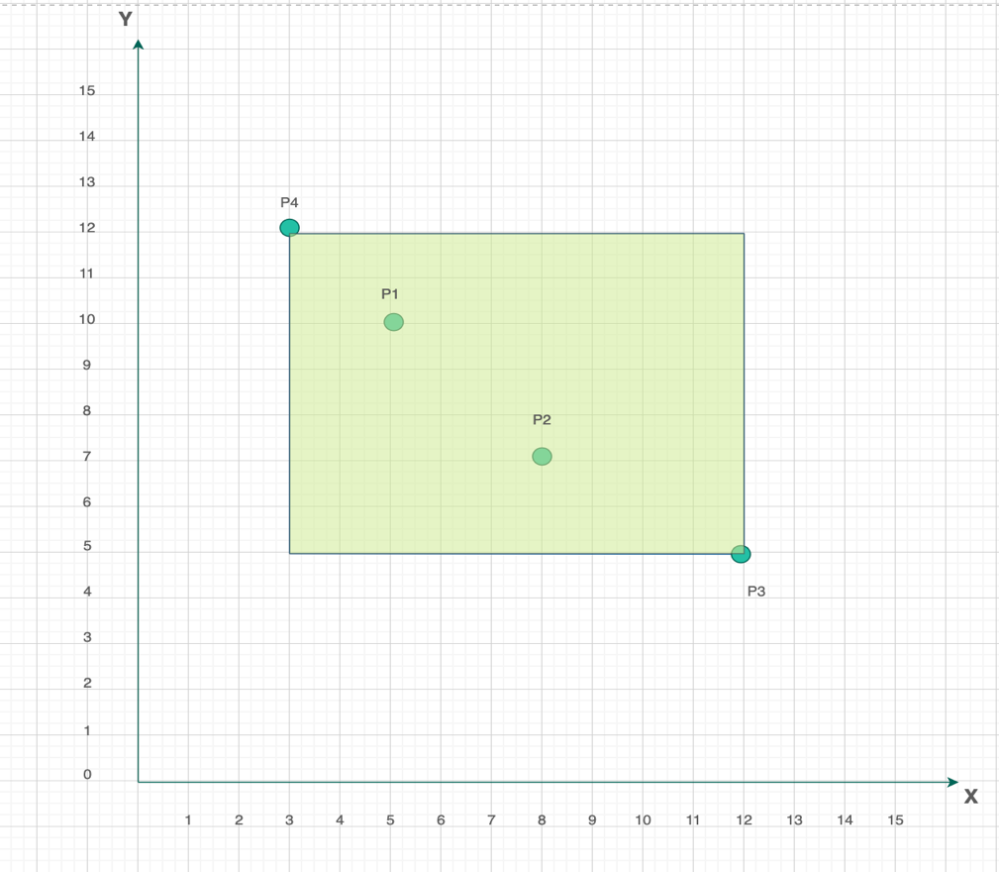
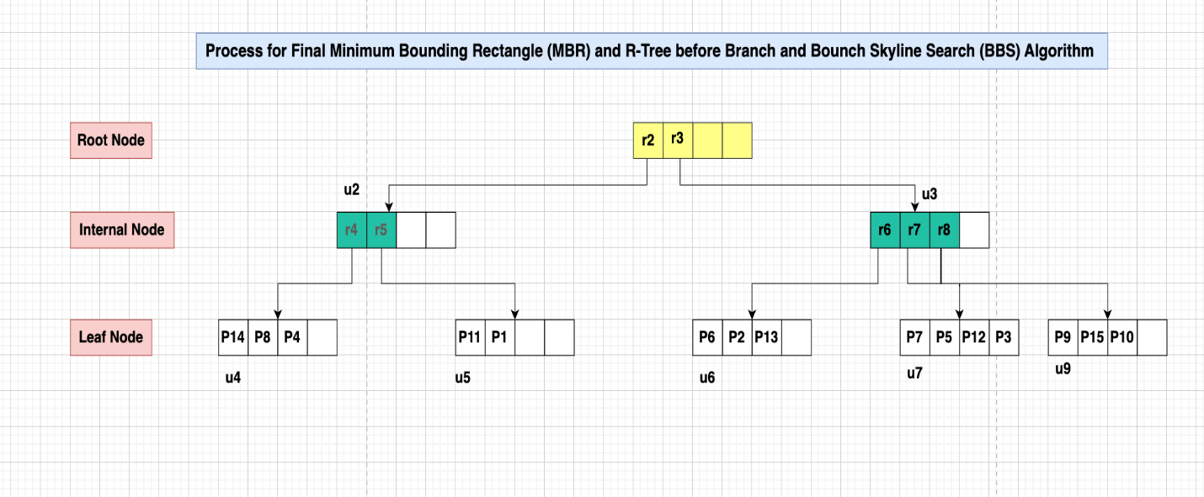
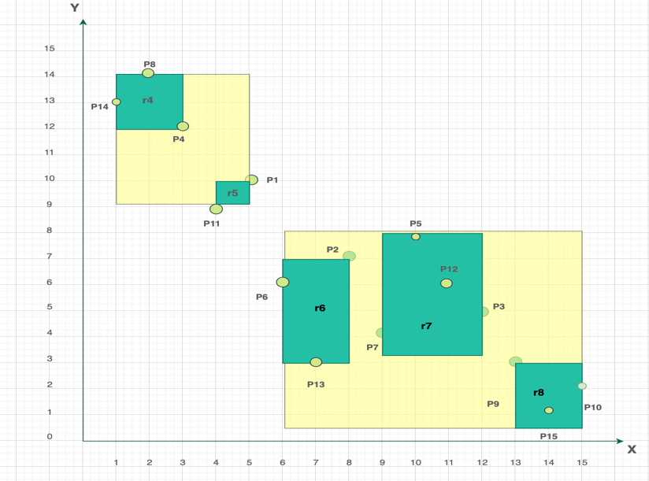
BBS ALGORITHM BASED SKYLINE SEARCH
BBS Algorithm
Root Node, Internal Node and Leaf Node
MBR and R-Tree Process
31

Slide 10
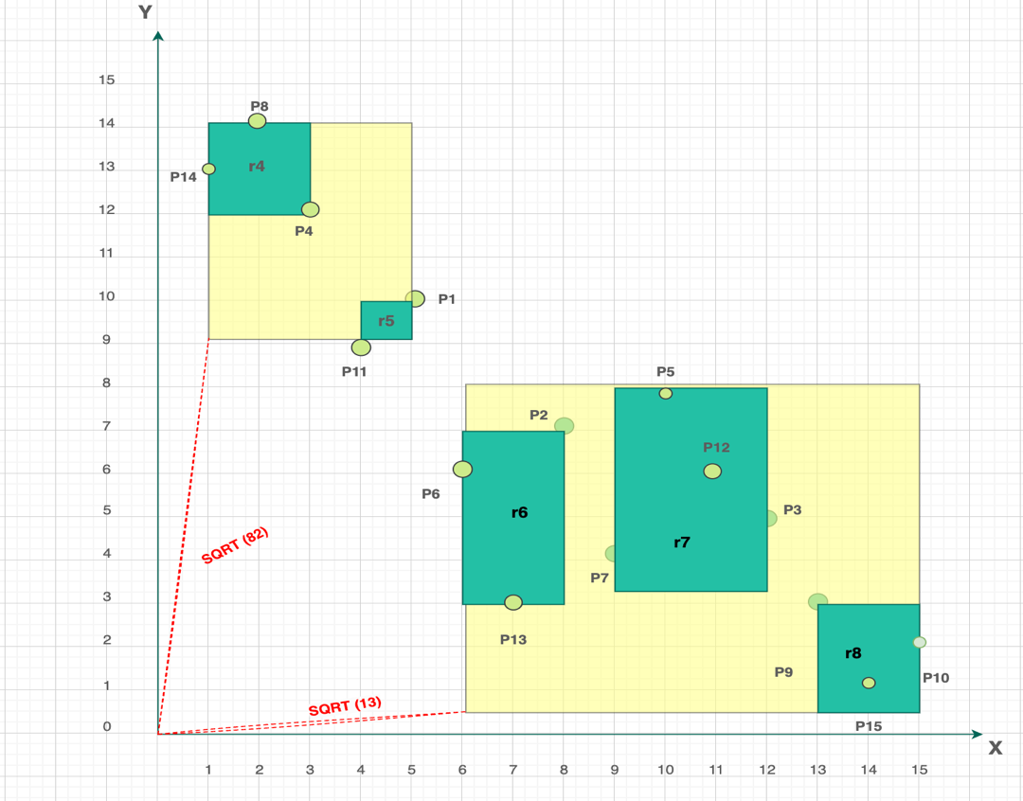
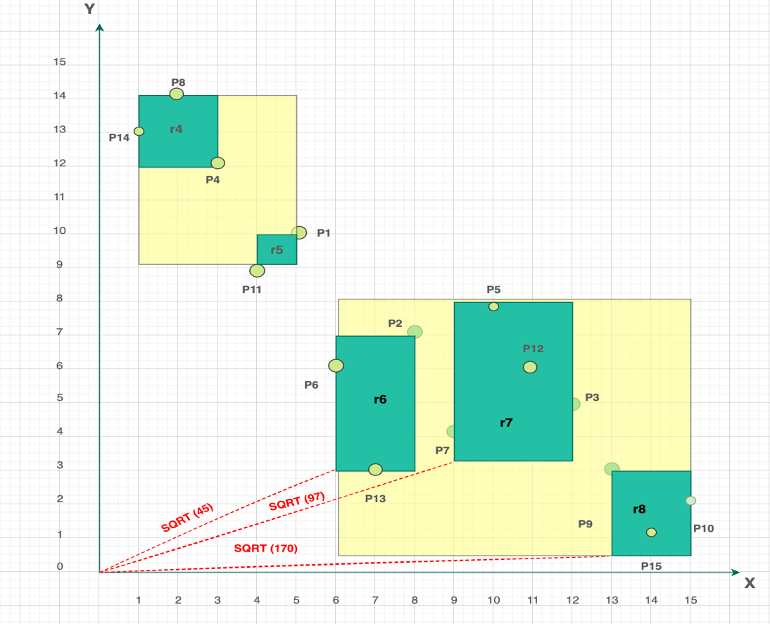
BBS ALGORITHM BASED SKYLINE SEARCH
BBS Algorithm
Distance from Origin to Root Node
Distance from Origin to u3 Child Node
36

Slide 11
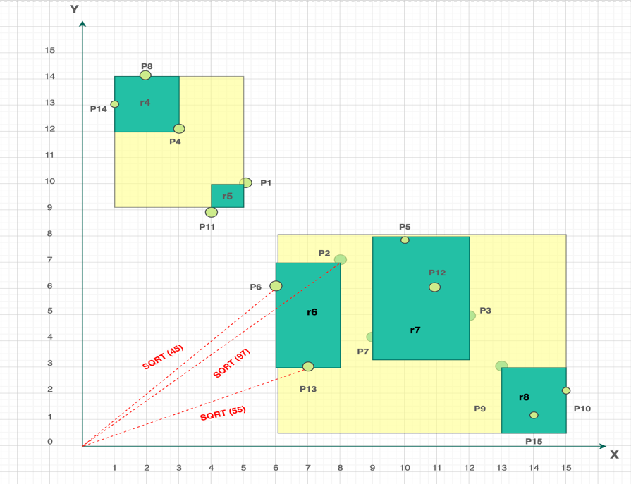
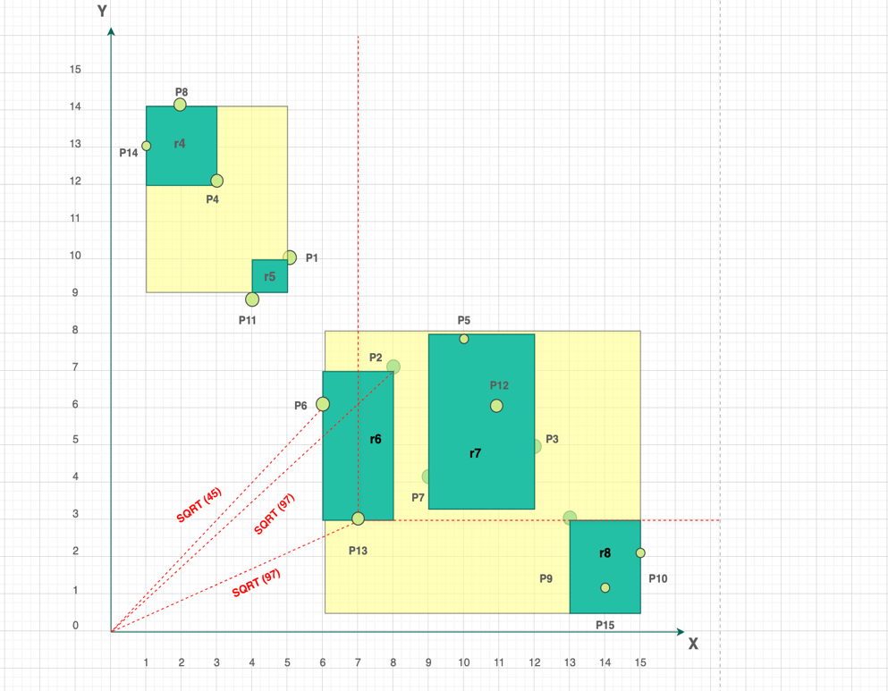
BBS ALGORITHM BASED SKYLINE SEARCH
BBS Algorithm
Distance from Origin to r6 Child Node
X-coordinates and Y-coordinates (after P13)
36

Slide 12
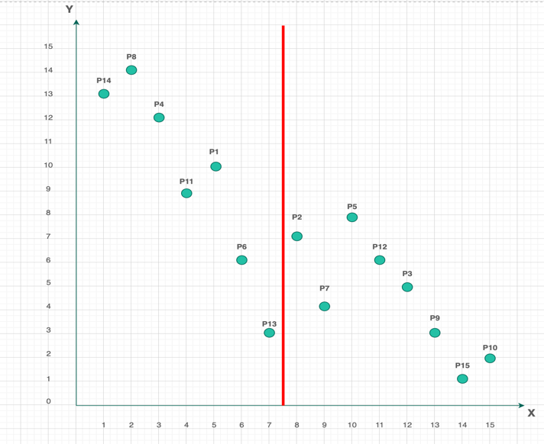
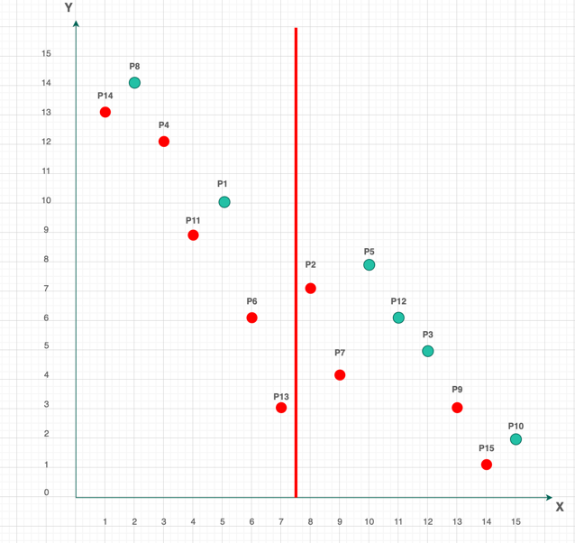
BBS ALGORITHM BASED SKYLINE SEARCH
Divide and Conquer BBS Algorithm
Skyline points shown using Divide and Conquer Approach in X-axis
37

Slide 13
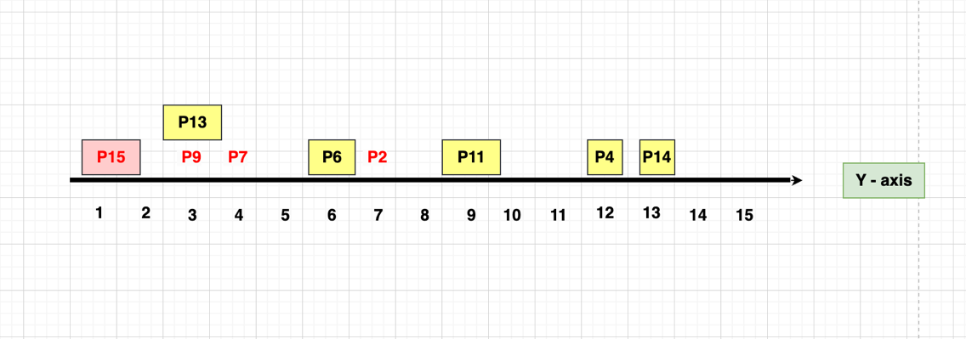
BBS ALGORITHM BASED SKYLINE SEARCH
Divide and Conquer BBS Algorithm
Skyline Points sorting in Y-axis
37

